Slide 1
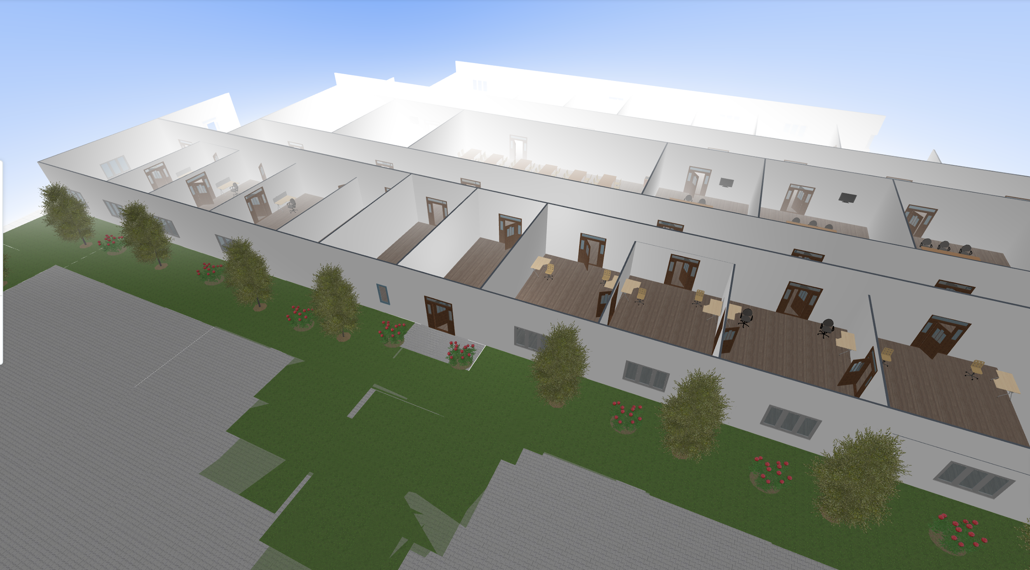
1 Story Office Building Mockup
Project Team #4:
Liang Liu
Rangeley Delphin
Kareem Belle
Ronald Yonggi
Nozim Khodjaev

Slide 2
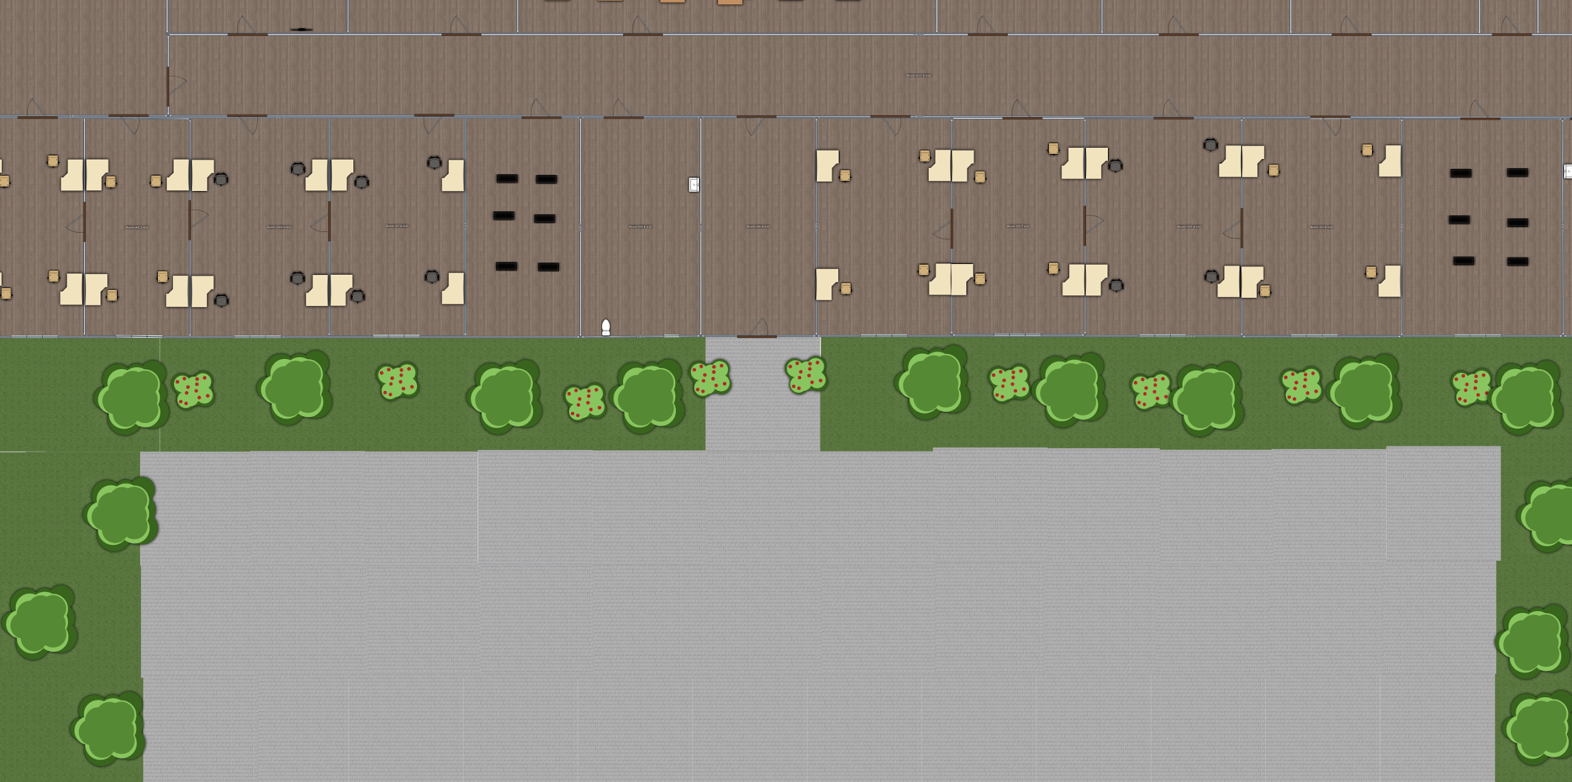
Overview
Office building that fits at least 50 employees
Dimensions 36.72m x74.69m x 4m
6 bathrooms, handicap accessible, unisex
In-building cafeteria
5 conference rooms
Parking spots for 50 employees + 10 guests

Slide 3
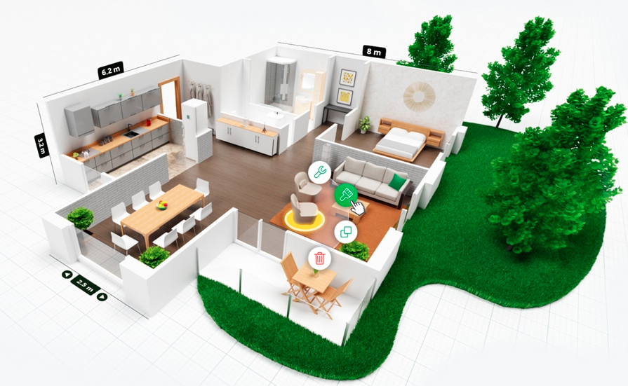
Tool for Design: Planner 5D
Free to use
2D and 3D design features for buildings, walls, basic furnitures

Slide 4
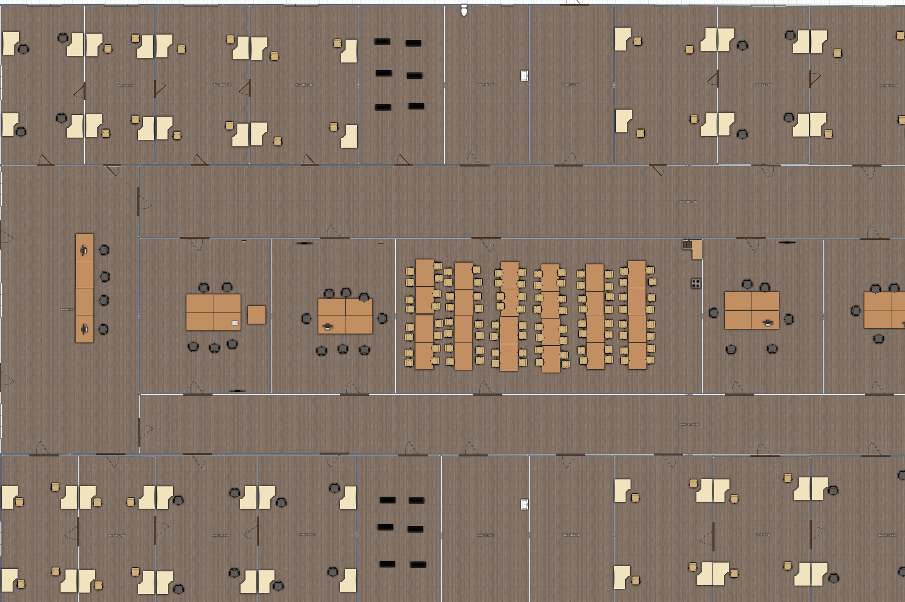
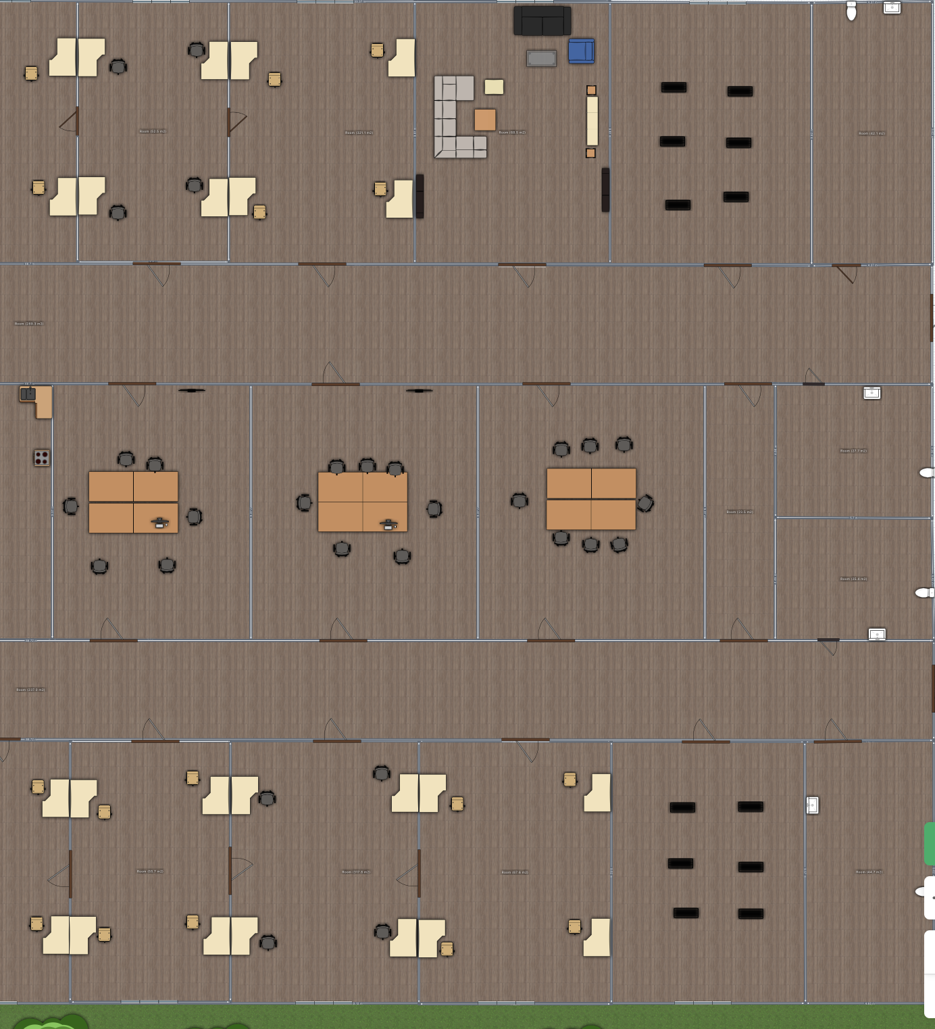
Floor Plan
Keypoints:
General Office space within central Island allowing for easy access.
Office spaces connect on opposite sides of the building allowing employees to easily collaborate when necessary.
Exits and entrances are all set at central positions on each wall.

Slide 5
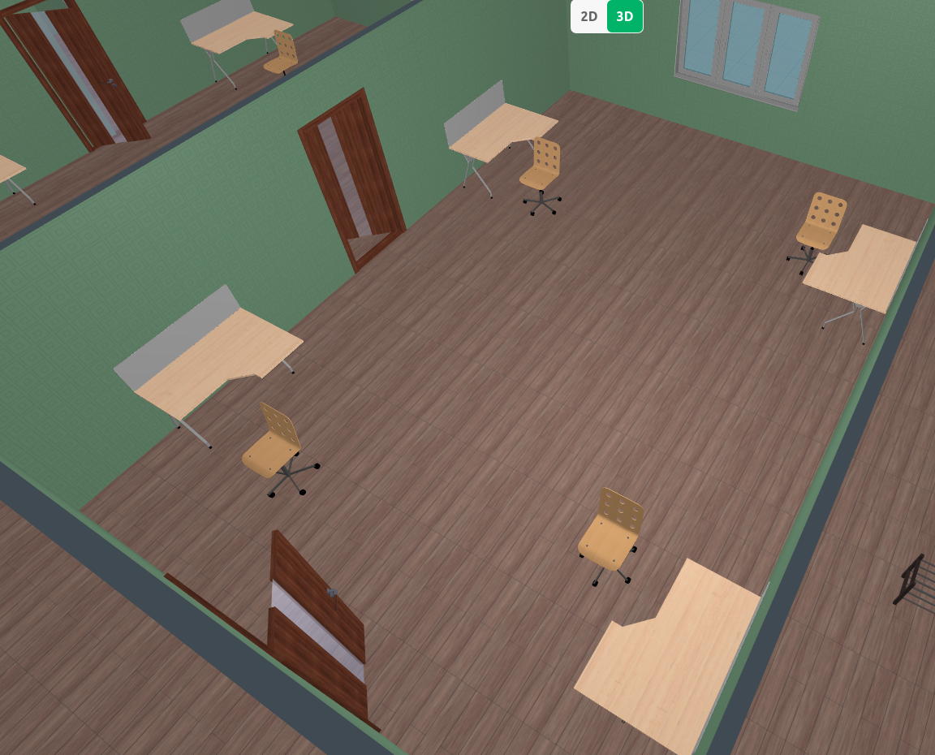
Office Rooms
15 office rooms
Each room fits 4 employees (desk and PC/ laptops)

Slide 6
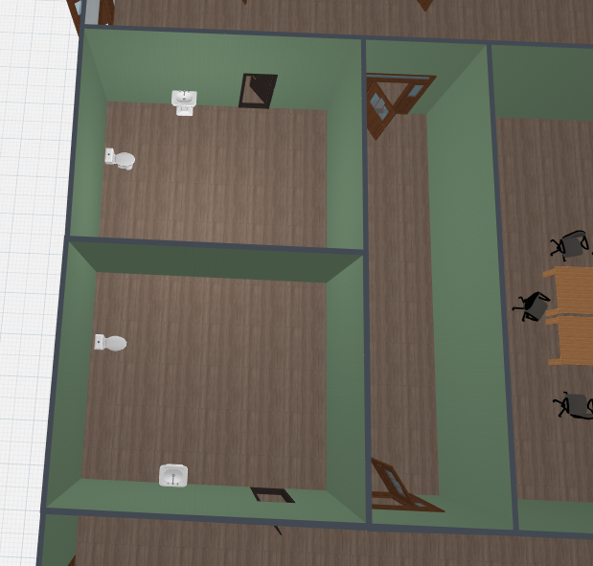
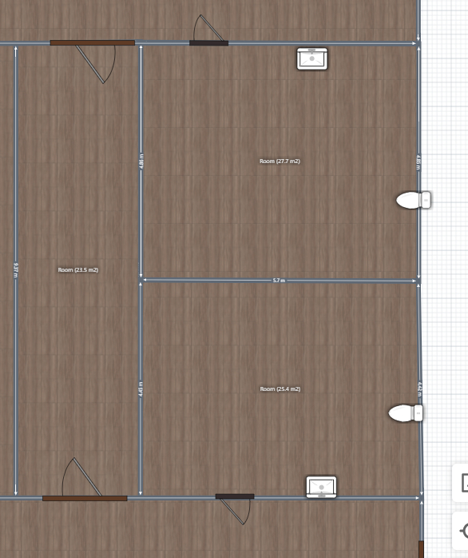
Bathroom
6 Bathrooms, Unisex, Handicap-Accessible

Slide 7
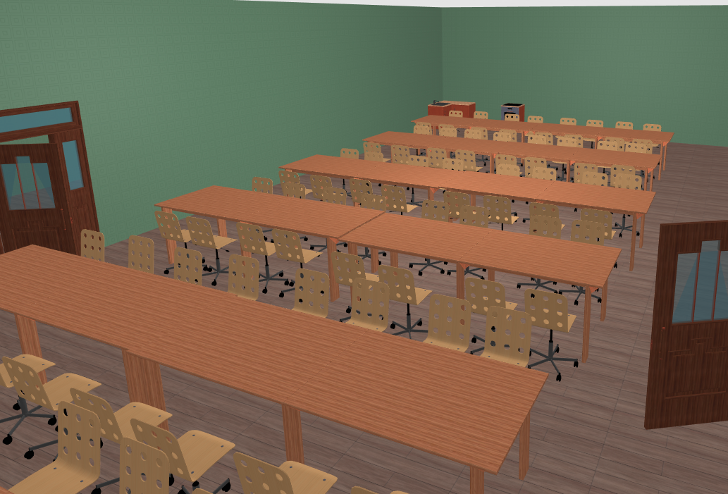
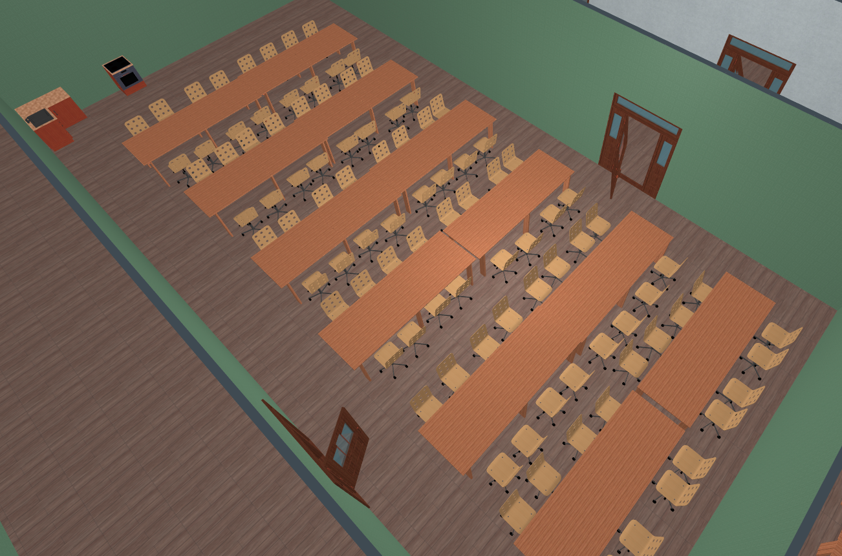
Cafeteria
Tables and chairs fit roughly 100 people sitting on the same time
Basic kitchen necessities

Slide 8
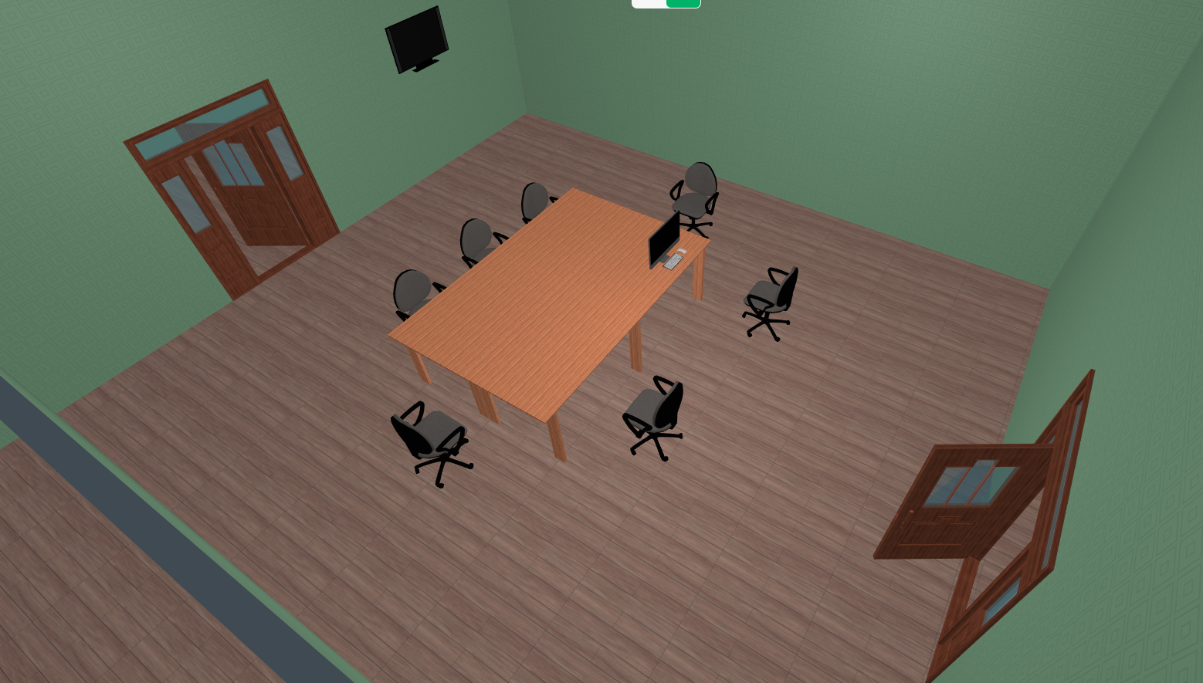
Meeting Room
5 meeting rooms in total
Projectors available in each room

Slide 9
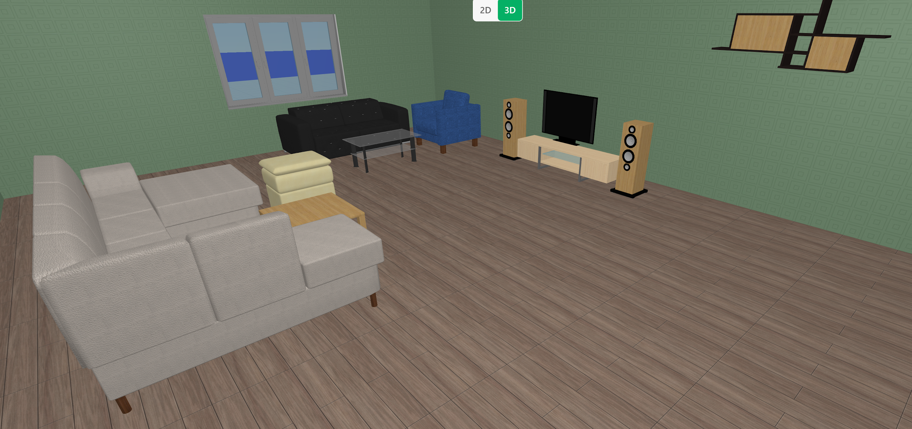
Lounge Room
Sofa
Coffee table
TV
Bookshelves
Employees can relax here.

Slide 10
Feedback
Positive:
Members were able to pitch in ideas and collectively execute
Negative:
Current tool (planner 5D) doesn’t allow multiple users collaboration
Bottleneck for work efficiency
What can be improved:
Should spend more time on planning phase, get a better layout, would save more time than trying to fix layout problem that encountered later during the work.

Slide 11
THANK YOU FOR YOUR ATTENTION

